Slide 1
TEXT Image classification

Slide 2
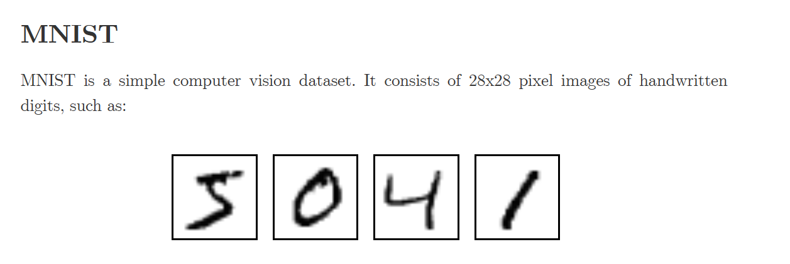
MNIST-784 dataset

Slide 3
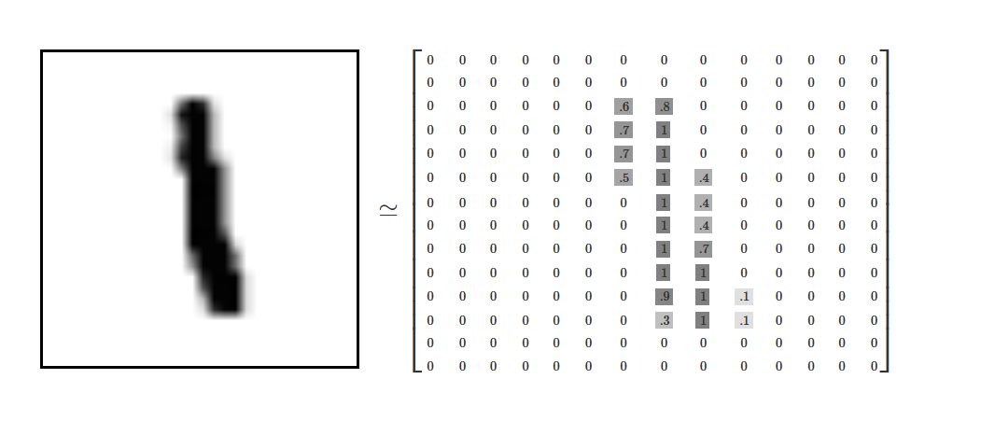
Every MNIST data point, every image, can be thought of as an array of numbers describing how dark each pixel is. For example, we might think of as something like:
Since each image has 28 by 28 pixels, we get a 28x28 array. We can flatten each array into a 28∗28=784 dimensional vector.

Slide 4
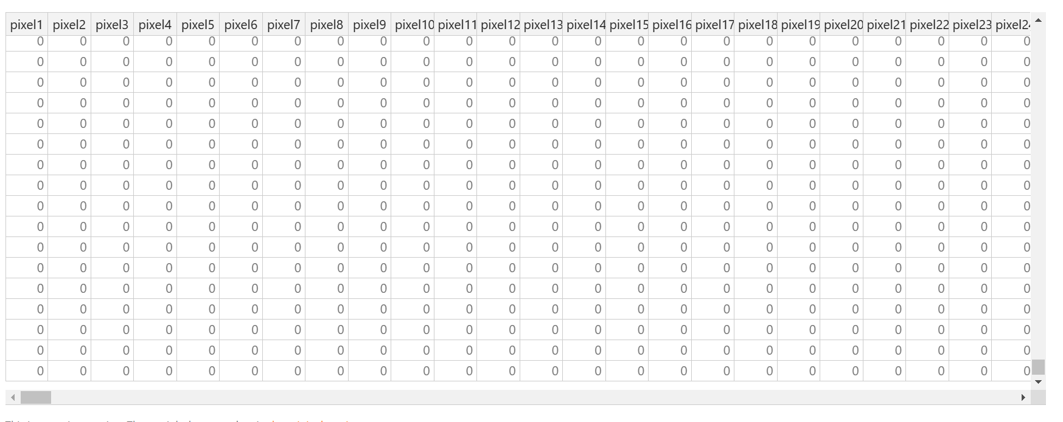

Slide 5
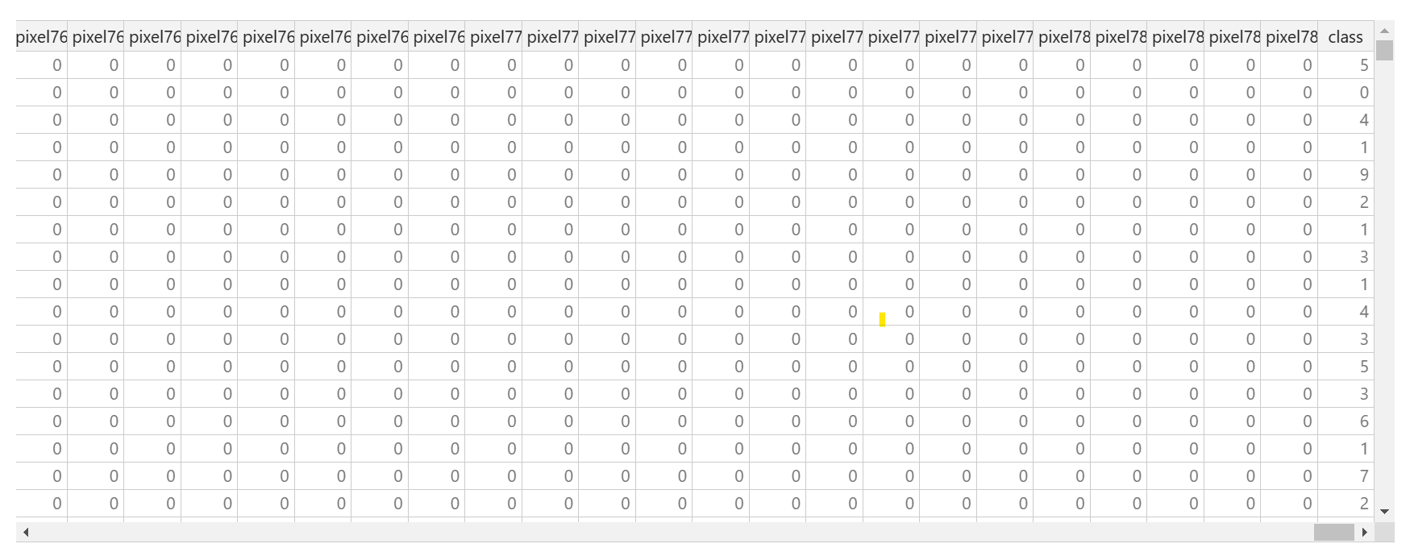

Slide 6
DATASET
Training:60000 images
Testing:10000 images

